Slide 1
Threading In Java

Slide 2
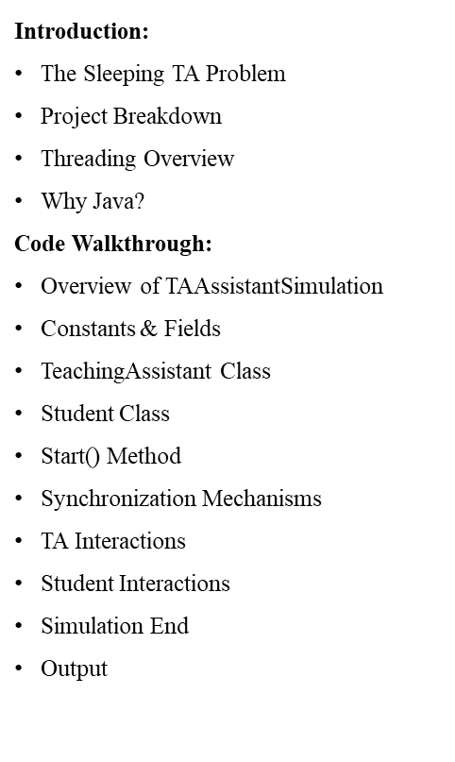
Overview
Additions:
Appointment Scheduling
Purpose and Student Process
TA Process and Benefits
Conclusions:
Overview of TAAssistantSimulation

Slide 3

Introduction

Slide 4
The Sleeping TA Problem
A university computer science department has a teaching assistant (TA) who helps undergraduate students with their programming assignments.
The TA’s office is rather small and has room for only one desk with a chair and computer.
There are three chairs in the hallway outside the office where students can sit and wait if the TA is currently helping another student.
When there are no students who need help, the TA sits at the desk and takes a nap.
If a student arrives and finds the TA sleeping, the student must awaken the TA to ask for help.
If a student arrives and finds the TA currently helping another student, the student sits on one of the chairs in the hallway and waits.
If no chairs are available, the student will come back at a later time.

Slide 5
Project Breakdown
Thread Management:
Create n student threads, each representing an individual student.
TA will also run as a separate thread.
Student Actions:
Students seek help from the TA.
If TA is available, students receive help immediately.
If TA is busy:
Students check for an available chair in the hallway.
If no chairs are available, students leave and return after a random time.
TA Behavior:
TA sleeps when no students are present.
If a student arrives and finds the TA asleep, they wake the TA using a semaphore.
After helping a student, the TA checks for waiting students in the hallway.
If students are waiting, the TA assists each in turn.
If no students are waiting, the TA returns to napping.
Simulating Help Time:
Both TA and students simulate time for providing or receiving help by sleeping for a random period.

Slide 6
Threading Overview
Multithreading Concept:
Allows multiple threads (like TA and students) to run simultaneously.
Ideal for scenarios where multiple entities need to operate independently and potentially interact.
TA and Student Threads:
Each student is represented by a separate thread, allowing concurrent actions (e.g., arriving, waiting, or leaving).
The TA also operates as a separate thread, providing help, waiting, or sleeping when needed.
Synchronization:
Semaphores and Locks ensure safe, orderly access to shared resources (e.g., chairs).
Conditions like the "sleeping TA" are controlled so students can wake the TA when necessary.
Concurrency Challenges:
Managing thread interactions, especially with limited resources like chairs.
Ensuring no thread is “starved” or left unattended, maintaining a fair help order.

Slide 7
Why Java?
Built-in Multithreading Support:
Java provides robust multithreading libraries, making it easier to handle concurrent tasks.
Thread, Runnable, Semaphore, and Lock classes offer powerful tools for implementing complex threading behavior.
Portability:
Java’s platform independence allows code to run consistently across different environments, beneficial for simulations.

Slide 8
Why Java? Cont…
Ease of Synchronization:
Java’s synchronization mechanisms (e.g., synchronized blocks,
ReentrantLock, and Condition) make it easier to manage thread interactions.
Java's high-level concurrency API provides clear, readable code for managing threads and resources.
Memory Management:
Java’s garbage collection reduces memory management overhead, which can be critical in multithreaded applications where memory allocation may vary.

Slide 9

Code Walkthrough

Slide 10
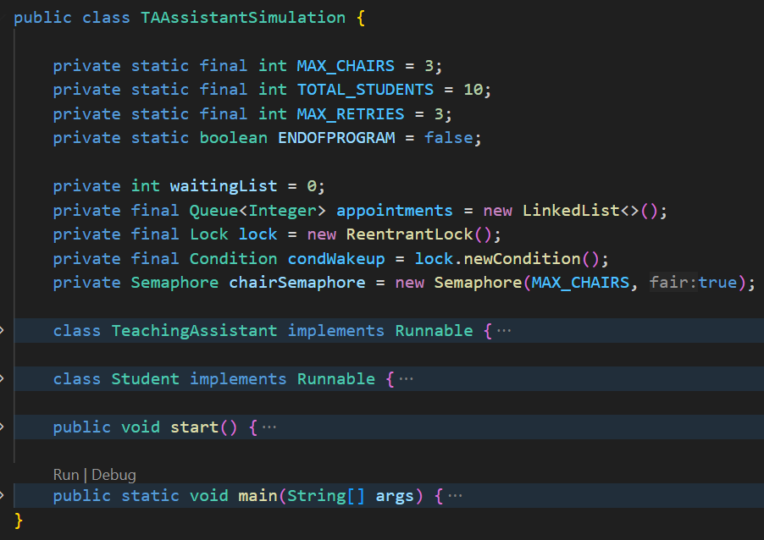
Overview of TAAssistantSimulation
Purpose:
This code simulates a Teaching Assistant (TA) office scenario where students arrive to ask questions. Students either wait in a limited seating area or, if full, attempt to make appointments.
Classes Involved:
TAAssistantSimulation: Main class containing the simulation.
TeachingAssistant: Inner class representing the TA.
Student: Inner class representing each student.
Key Concepts:
Multithreading, synchronization, semaphores, locks, and conditions.

Slide 11
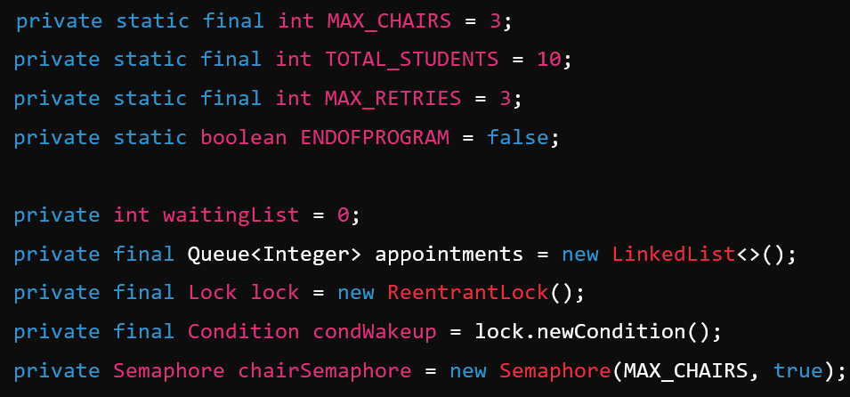
Constants & Fields
Constants:
MAX_CHAIRS: Maximum number of chairs (3) available in the TA's office.
TOTAL_STUDENTS: Total students in the simulation (10).
MAX_RETRIES: Number of attempts a student makes to sit before opting for an appointment (3).
ENDOFPROGRAM: Flag to signal the end of the simulation.
Fields:
waitingList: Tracks students waiting in chairs.
appointments: Queue for students who have made appointments.
lock: Ensures thread-safe access to shared resources.
condWakeup: Condition for waking the TA when students arrive.
chairSemaphore: Manages the limited seating.

Slide 12
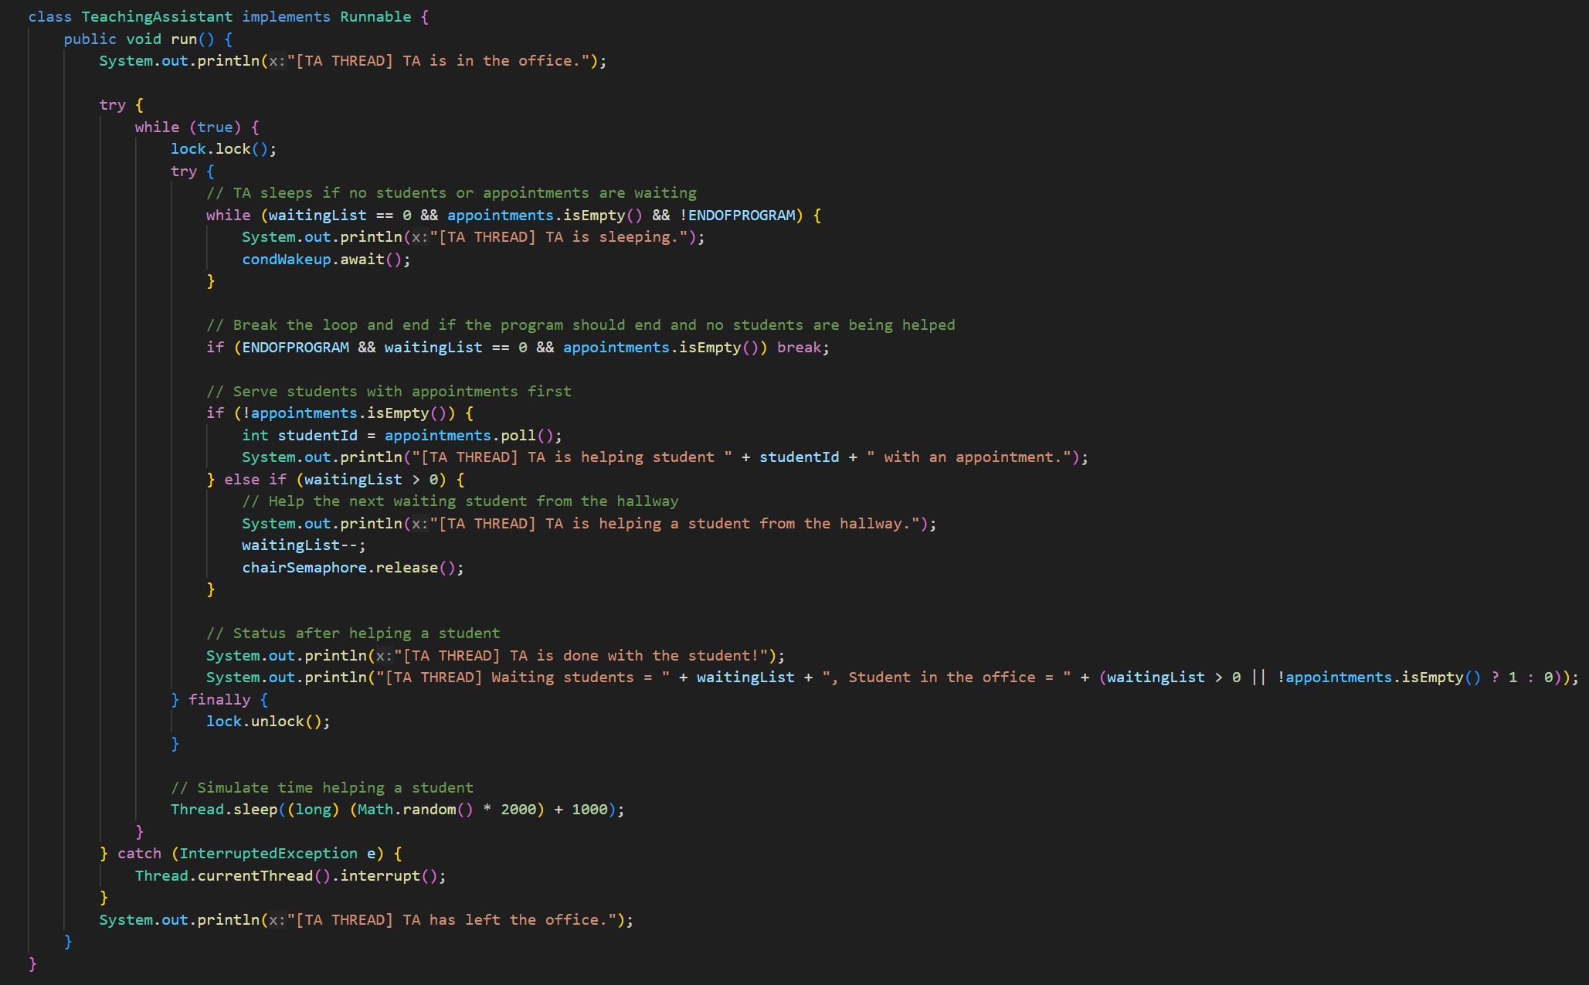
TeachingAssistant Class
Role:
The TeachingAssistant class implements the Runnable interface, defining behavior for the TA in a separate thread.
Methods:
run(): Core method where the TA alternates between helping students and "sleeping" if no one is present.
Process:
TA sleeps (condWakeup.await()) if waitingList and appointments are empty.
If students are waiting, the TA helps them in a First-Come-First-Served order.
After assisting a student, the TA waits to help the next one or goes back to sleep.
End Condition:
TA exits if ENDOFPROGRAM is set and no students remain.

Slide 14
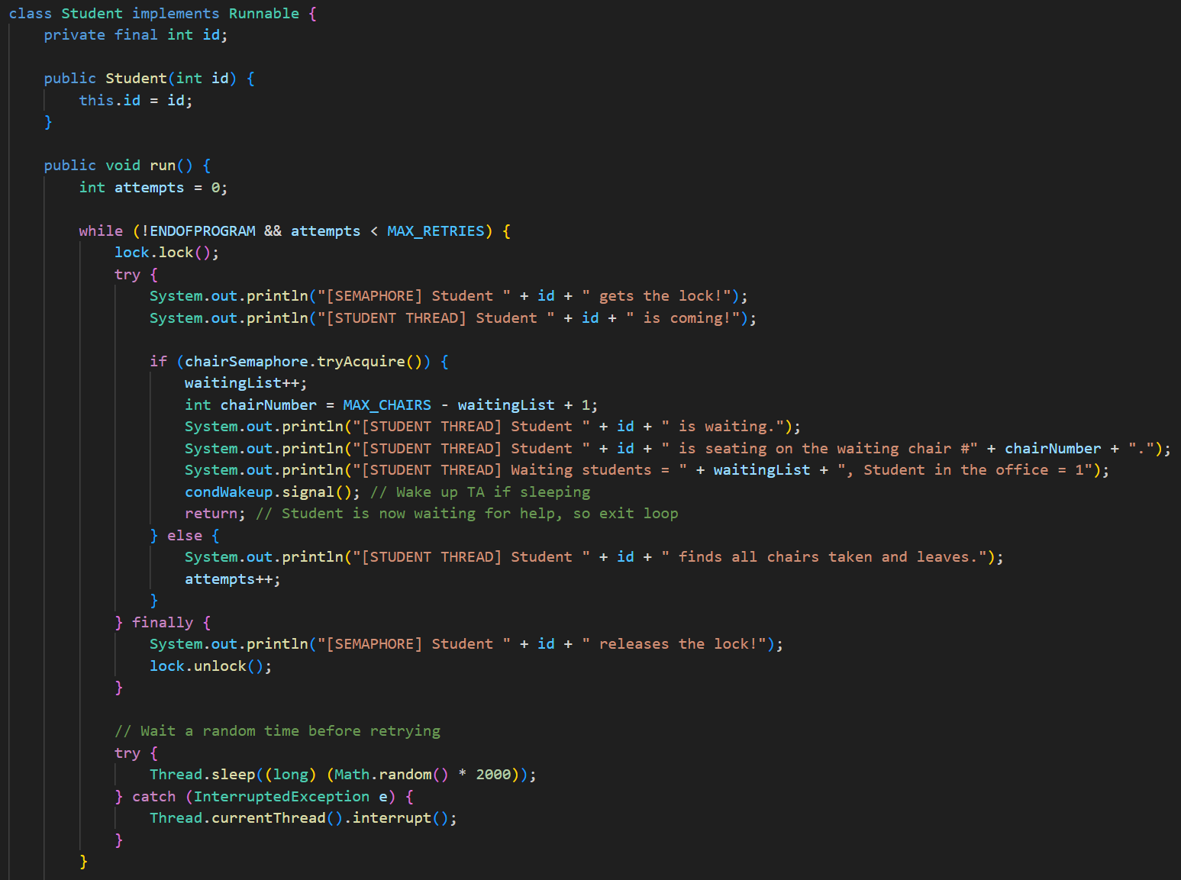
Student Class
Role:
Each Student represents a student trying to meet the TA, either by sitting in a waiting chair or, if chairs are full, scheduling an appointment.
Methods:
run(): Main logic where each student tries to visit the TA.
Process:
Attempts to acquire a chair by checking the chairSemaphore.
If successful, increments waitingList, indicating they are waiting for the TA.
If no chair is available, retries up to MAX_RETRIES before making an appointment.
After making an appointment, the student leaves, and the appointment is added to the queue.

Slide 16
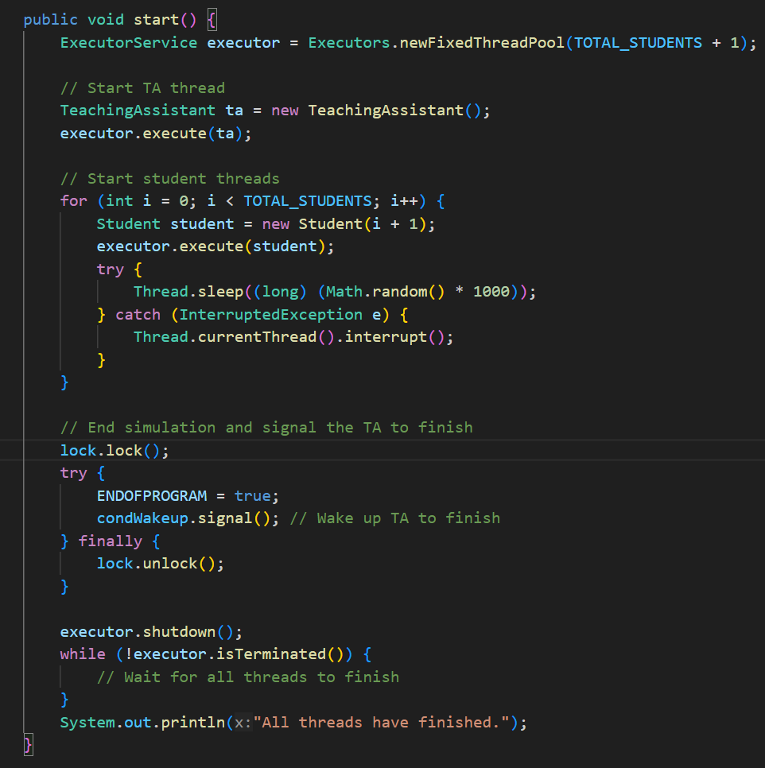
start() Method
Role:
Initializes the simulation by creating threads for the TA and each student.
Process:
Initializes an ExecutorService with a thread pool to manage concurrent threads.
TA Thread:
Creates and starts the TeachingAssistant thread.
Student Threads:
Loops through TOTAL_STUDENTS, creating a thread for each student with a slight delay to simulate staggered arrivals.
End Simulation:
Sets ENDOFPROGRAM to true, signaling the TA to finish, and shuts down the ExecutorService.

Slide 18



Synchronization Mechanisms
lock:
condWakeup:
chairSemaphore:
Locks and Condition Variables:
lock: Ensures safe access to shared variables like waitingList and appointments.
condWakeup: Condition that allows the TA to "sleep" when there are no students and "wake up" when a student arrives.
Semaphores:
chairSemaphore: Manages the limited seating, ensuring only up to MAX_CHAIRS students can wait at any time.

Slide 19
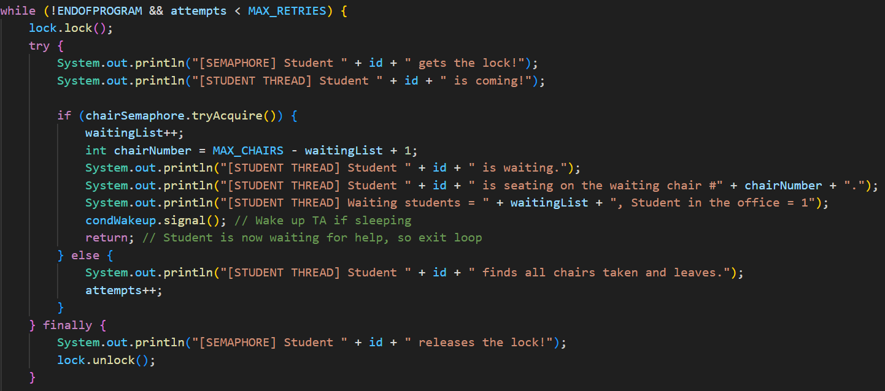
Student Interaction
Student Interaction:
Students attempt to acquire a chair; if unsuccessful after 3 tries, they make an appointment.
condWakeup.signal() is called by students to notify the TA upon arrival or making an appointment.

Slide 20
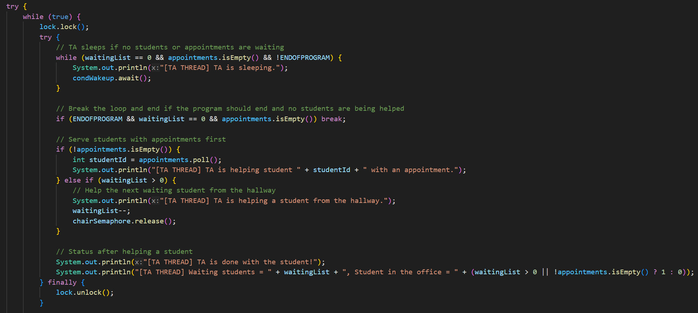
TA Interaction
TA Interaction:
TA uses the lock to check for waiting students or appointments.
TA "sleeps" when no students are present and is woken up by condWakeup when students arrive.

Slide 21
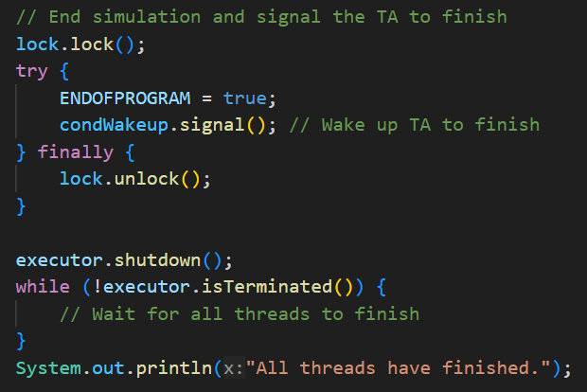
Simulation End
Ending the Simulation:
ENDOFPROGRAM is set to true to signal the TA to finish once all students are processed.
condWakeup.signal() is used to wake the TA if they are waiting for students and ensure the TA finishes its loop.

Slide 22
Output
Output Statements:
Each step is logged with meaningful messages that trace the flow of the program, providing insights into:
When students arrive and leave. students need
When the TA is helping a student.
When chairs are full and appointments.
Useful for debugging and understanding the sequence of events.

Slide 23
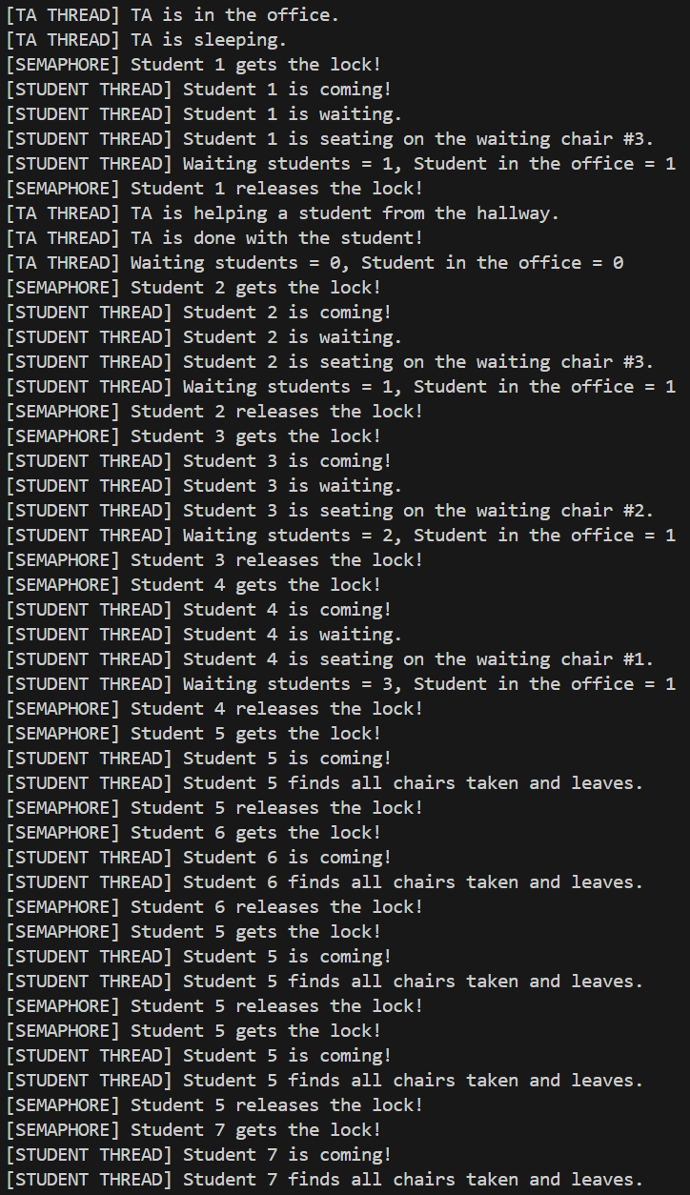
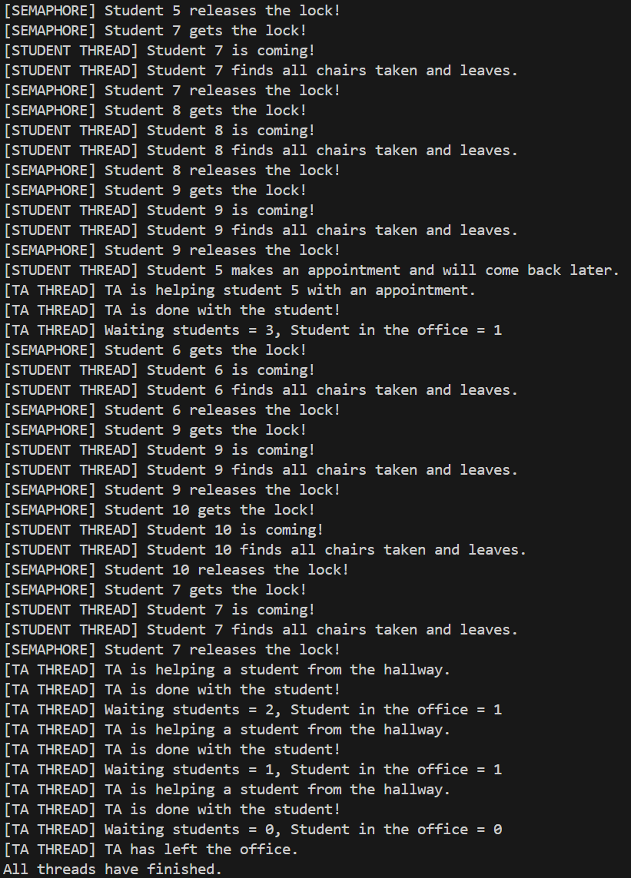
Sample Output

Slide 24
Additions

Slide 25
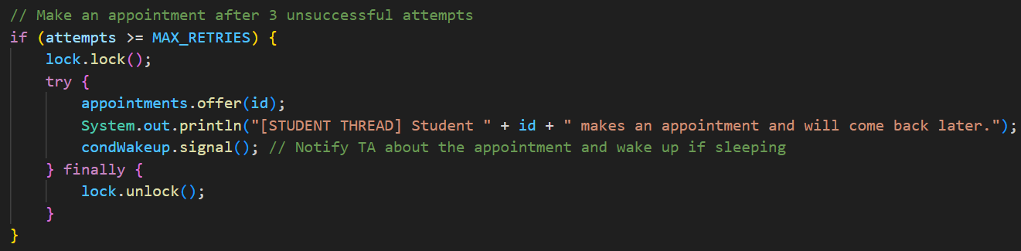
Appointment System
Purpose:
Allows students to schedule appointments if they cannot find an available chair after multiple attempts, ensuring they still receive assistance from the TA.
Student Process:
Each student has up to 3 attempts to find an available chair.
If all chairs are occupied, and they’ve exceeded the retry limit, they schedule an appointment.
The student is then added to the appointments queue.

Slide 26

Appointment System cont…
TA Process:
The TA checks the appointments queue first when students are waiting.
If there are appointments, the TA helps the next student in the queue.
Benefits of the Appointment System:
Ensures fairness by providing every student a guaranteed way to receive help.
Reduces wait times for students who would otherwise have to wait for a chair.
Allows the TA to manage students efficiently without leaving anyone unattended.

Slide 27

Conclusions ​
Key Takeaways from the TA Simulation:
Effective Synchronization:
The use of locks, condition variables, and semaphores ensured safe, controlled access to shared resources.
Each synchronization mechanism played a role in managing student traffic and ensuring the TA could sleep and wake as needed.
Scalability and Fairness:
The appointment system added a layer of fairness, ensuring every student eventually received assistance, even during peak demand.
The limited seating arrangement and retry mechanism simulated real-world constraints in a manageable way.
Thread Coordination:
Threads interacted seamlessly, demonstrating a well-coordinated system where students and the TA could function independently while waiting for or providing assistance.

Slide 28
Conclusions ​
Real-World Applications:
Concepts applied here—like controlled resource access, appointment systems, and efficient thread management—are directly applicable to real-world scenarios involving limited resources and high demand.
Debugging and Traceability:
Detailed logging and output statements made it easier to trace each event, aiding in debugging and ensuring the correct flow of operations.
Future Improvements:
Enhanced Student Prioritization: Introducing more advanced priority mechanisms could improve the efficiency of student handling.
Dynamic Chair Allocation: Adjusting the number of chairs based on demand could allow a more flexible system.
Final Thoughts:
This simulation highlighted the power of multithreading and synchronization in managing concurrent processes effectively, showcasing a practical approach to resource sharing and task scheduling.

